Slide 1
HEC Montréal École de Gestion
HEC Montréal École de Gestion
University of Mumbai
Department of Electronics and Telecommunication Engineering
K. J. Somaiya College of Engineering, Mumbai
(Autonomous College Affiliated to University of Mumbai)
PREDICTION BASED PLANT WATERING SYSTEM
Submitted in partial fulfilment of requirements
For the degree of
Bachelors in Technology
(2015-19)
Semester VIII
‹#›

Slide 2
Project by
Zainab Khokawala | 1513088
Niti Patel | 1513098
Moiz Balasinorwala | 1513067
Adnan Dedhawala | 1513075
Guide
Mrs. Jayshree Kundargi
Date
11th May 2019
Department of Electronics and Telecommunication Engineering Semester VIII 2015-19

Slide 3
Outline
Introduction
Literature Survey
Proposed Method
Result and Analysis
Conclusion
Future Scope
References
Department of Electronics and Telecommunication Engineering Semester VIII 2015-19

Slide 4
Introduction
The advent of technology in making our daily lives easier and solving a lot of issues based on real life scenarios has spurred in recent times.Gardening is one such daily life activity which as has an increasing importance beyond it just being a hobby.Considering the future environmental factors, it is believed that most of us may need to take up gardening ourselves.
However the issue is that most people lack the knowledge of the amount of water and nutrients required for the plant to stay healthy. Therefore, it is required to create an automated system that can predict the water required in the plant everyday, since water is one of the essential factors that contributes towards plant’s growth. Furthermore, the system should also contribute towards conservation of water.
Department of Electronics and Telecommunication Engineering Semester VIII 2015-19

Slide 5
Motivation
Discussion to work on a project that addresses a daily life issue and also bridges the gap between theory and practice.
Decision on working on a plant based idea, that helps maintain plant health efficiently.
Using the technology to develop an automated watering system that is less tedious, less time consuming and saving water.
Department of Electronics and Telecommunication Engineering Semester VII 2015-19

Slide 6
Objectives
To develop a system that is capable of predicting the water level required for the healthy growth of a plant.
In order to detect this water level the system should be capable of extracting target parameters such as temperature, humidity, soil moisture.
The proposed system employs machine learning to facilitate the prediction of water level with the inputs being these target features.
Also, the system should be robust and efficient against different seasons faced by the plant and contribute towards water conservation.
Department of Electronics and Telecommunication Engineering Semester VII 2015-19

Slide 7
Objectives
The proposed system should be automated and consist of a watering system that makes it an independent product which leaves the user free of worry with healthy plants.
Department of Electronics and Telecommunication Engineering Semester VII 2015-19

Slide 8
Literature Survey
Hamlyn G. Jones. (2007). Monitoring plant and soil water status.
The paper says that measurement of water status of a plant along with environmental stress gives us a better information about the water movement in plant system.
Salim, M. (1989). Effects of salinity and relative humidity on growth and ionic relations of plants
Experiments were performed on tomato,mung bean sunflower,red kidney bean and aspongiosa plants by varying concentration of NaCl and relative humidity.
Cowling, S. A., & Sage, R. F. (1998). Interactive effects of low atmospheric CO2 and elevated temperature on growth, photosynthesis and respiration in Phaseolus vulgaris.
French bean plant was analysed to find the effects of low atmospheric C02 and elevated temperature on its growth.
Department of Electronics and Telecommunication Engineering Semester VII 2015-19

Slide 9
Literature Survey
Ananthi, N., Divya, J., Divya, M., & Janani, V. (2017). IoT based smart soil monitoring system for agricultural production.
Various sensors are used to test soil .The values obtained are sent to field manager and crop suggestions are made.
Pernapati, K. (2018). IoT Based Low Cost Smart Irrigation System.
Temperature and humidity sensors are used to sense the water vapour content and temperature around the plant. The system checks if the water content is below minimum requirement of plant and supplies water accordingly.
Gagandeep, Arora, D., & Saini, H. S. (2017). Design and implementation of an automatic irrigation feedback control system based on monitoring of soil moisture.
The paper is dealing with the development in agricultural activities of irrigation, soil moisture and temperature management using digital technologies and wireless sensors.
Department of Electronics and Telecommunication Engineering Semester VII 2015-19

Slide 10
Literature Survey
Qi, C., Wenbiao, W., & Siyuan, W. (2015). Application of indoor temperature prediction based on SVM and BPNN.
To understand support vector machine model and back propagation neural network model of temperature prediction.
Meng, L., Shi, J., Wang, H., & Wen, X. (2013). SVM with improved grid search and its application to wind power prediction.
Support vector machine model along with an improved grid search method is used to optimize the required parameters and predict the wind power.
Liu, S., & Zhou, F. (2010). On stock prediction based on KNN-ANN algorithm.
The paper says that KNN-ANN algorithms are smaller than those in KNN algorithm and can do better in stock prediction.
Department of Electronics and Telecommunication Engineering Semester VII 2015-19

Slide 11
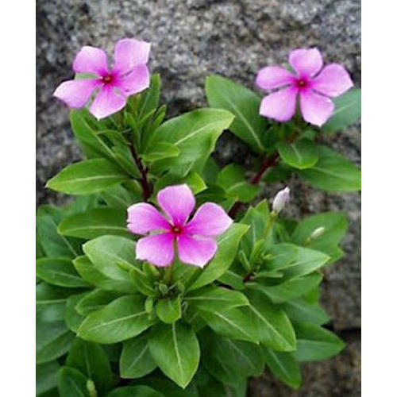
Vinca Plant
Vinca (/ˈvɪŋkə/ Latin: vincire "to bind, fetter") is a genus of flowering plants in the family Apocynaceae, native to Europe, northwest Africa and southwest Asia.
This plant is known by three names Vinca, Periwinkle and Myrtle.
It is a prolific heat and drought tolerant plant, perfect for hot, dry areas.
The plants are grown for its attractive glossy, green foliage, as well as its flowers. Flowers bloom all summer, and up to frost. Common colors include white, rose, pink, and red.
Department of Electronics and Telecommunication Engineering Semester VII 2015-19

Slide 12
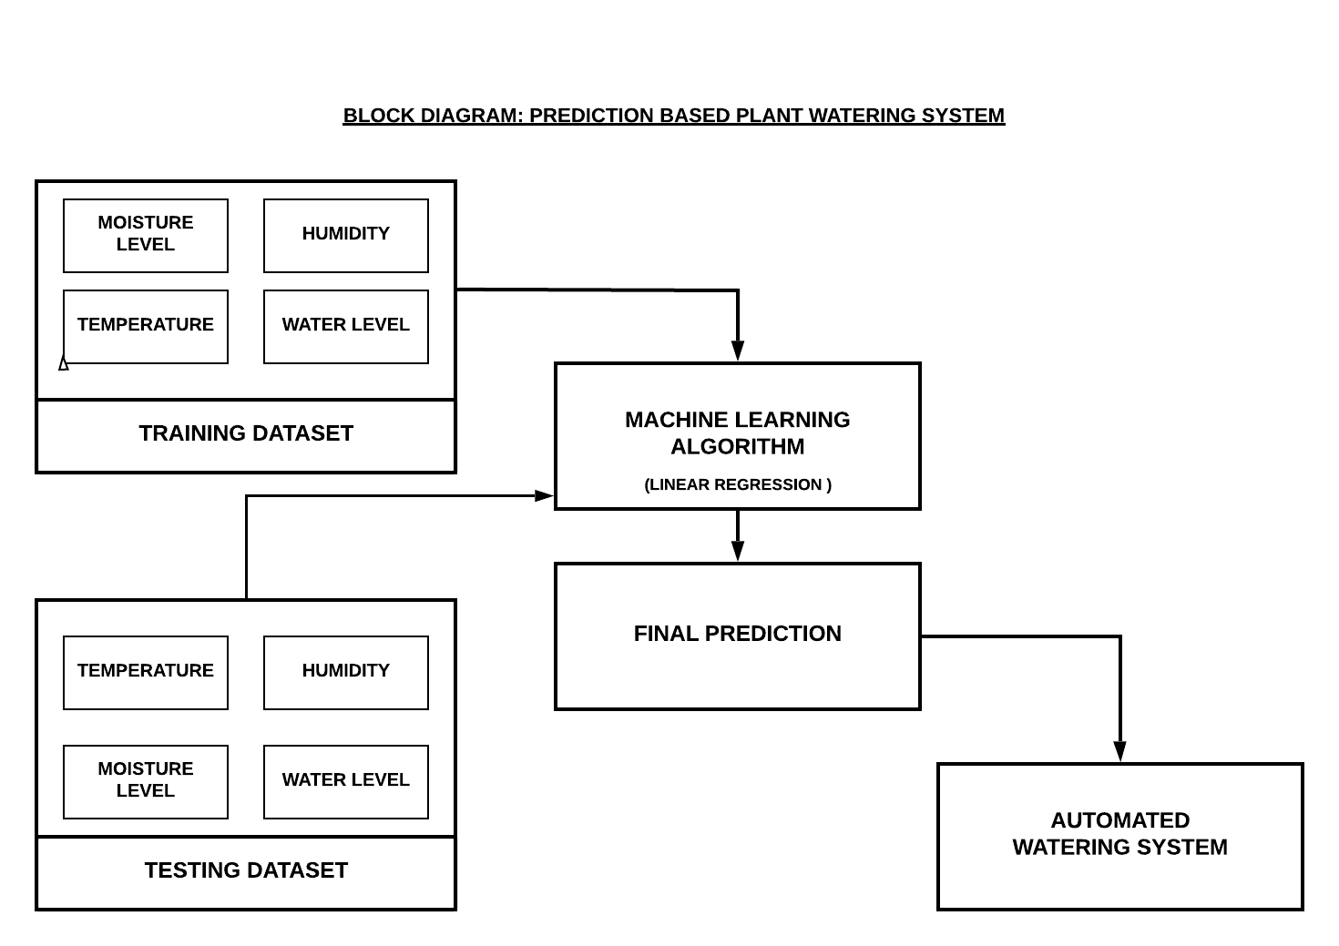
Proposed Method
Department of Electronics and Telecommunication Engineering Semester VIII 2015-19

Slide 13
Proposed Method
DATA COLLECTION
HARDWARE SETUP
SOFTWARE PREDICTION MODELS ANALYSIS
AUTOMATED WATERING SYSTEM
WEB APPLICATION

Slide 14
Database Collection
We have taken into account the following factors which will affect the water added to the plant-
Soil Moisture - with the help of a soil moisture sensor
Temperature - values obtained from Google Weather API
Atmospheric Humidity- values obtained from Google Weather API
Department of Electronics and Telecommunication Engineering Semester VIII 2015-19

Slide 15
Database Collection
The soil moisture, humidity, and temperature values formed the inputs whereas the amount of the water to be added formed the output.
The temperature and humidity values of the previous day and the soil moisture values of the current day were used to determine the amount of water to be added to the plant the current day.
Department of Electronics and Telecommunication Engineering Semester VIII 2015-19

Slide 16
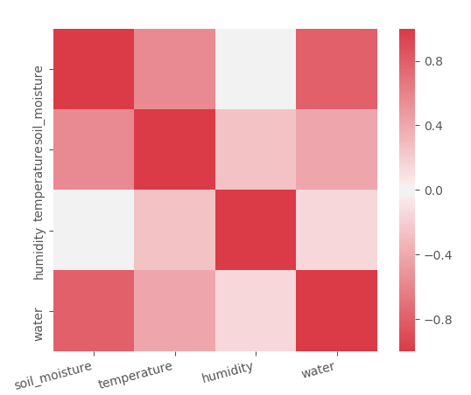
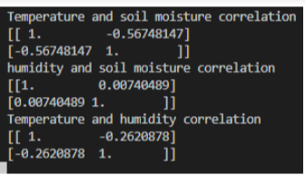
Correlation Plot
Correlation matrices
Correlation heatmap
Department of Electronics and Telecommunication Engineering Semester VIII 2015-19

Slide 17
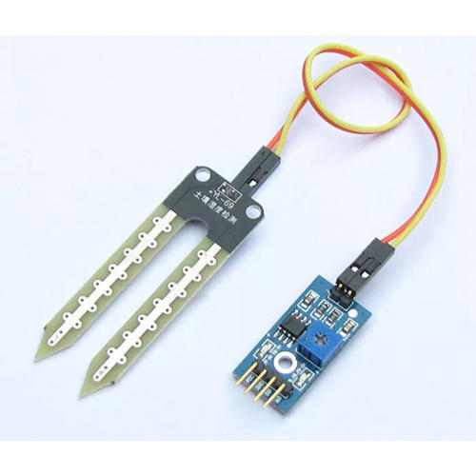
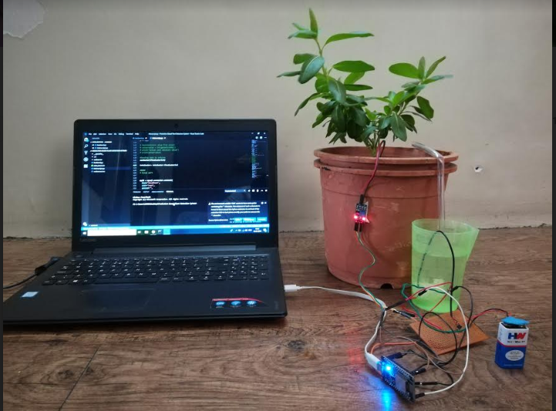
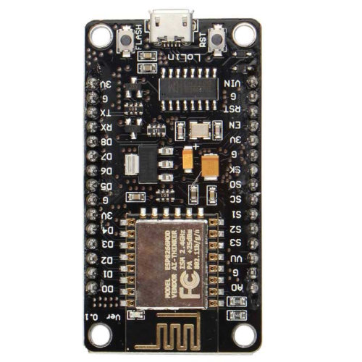
Hardware Setup
Soil moisture sensor
Nodemcu Board
Department of Electronics and Telecommunication Engineering Semester VIII 2015-19

Slide 18
Hardware Setup
Setting up ESP8266
Arduino IDE setup with the wifi module
Server connection for sending soil moisture values to prediction code
Receiving predicted value through wifi module
Automated watering system
Calibration of time(seconds) in accordance with the water value received
Circuit containing water pump which waters the Vinca plant
Department of Electronics and Telecommunication Engineering Semester VIII 2015-19

Slide 19
Software Code for Prediction
Data Visualization
Division into Training and Testing datasets
Model training using using SVM Regressor, Linear Regression, and KNN Regressor on training dataset
Prediction values on testing dataset
Error calculation and analysis
We have used supervised learning to train our regression models.
Department of Electronics and Telecommunication Engineering Semester VIII 2015-19

Slide 20
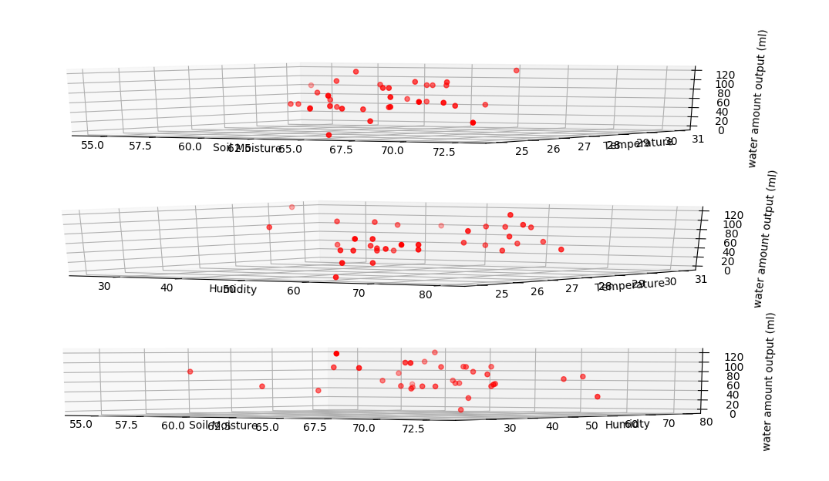
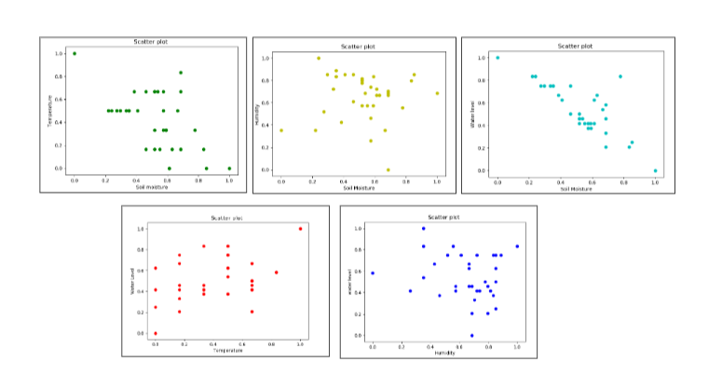
Data Visualization
2. Division into training and testing datasets The data has been divided into training-testing ratios of 80%-20%, 70%-30%, and 60%-40%
Department of Electronics and Telecommunication Engineering Semester VIII 2015-19

Slide 21
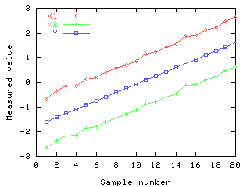
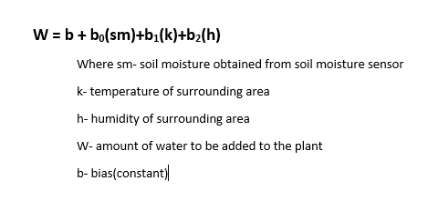
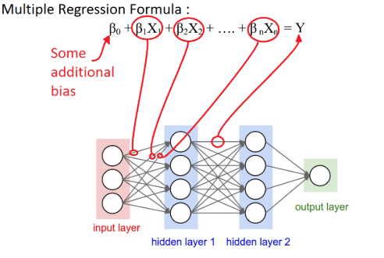
3. Models used for training- i) Multiple Linear Regression Model
There are 3 independent variables are temperature, humidity, and soil moisture and the dependent variable is amount of water to be added.
We establish a relationship between the dependent and independent variables using a best fit straight line. Using gradient descent, we minimize the cost function in order to obtain the regression line.
Department of Electronics and Telecommunication Engineering Semester VIII 2015-19

Slide 22
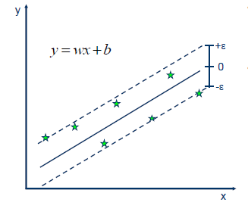
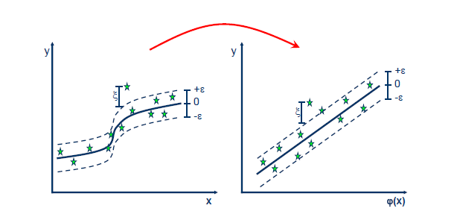



Models used for training- ii) Support Vector Regression Model
In SVR, the error is fit within some threshold, only the points which are within the boundary lines are considered. RBF kernel- The radial basis function kernel creates non-linear combinations which map lower dimensional data to higher dimensions. Linear kernel- when the data is linearly separable and fast training over a large dataset is required. Polynomial kernel- non-linear model and the kernel looks not only at features of input samples to find similarity, but also their combinations.
Department of Electronics and Telecommunication Engineering Semester VIII 2015-19

Slide 23
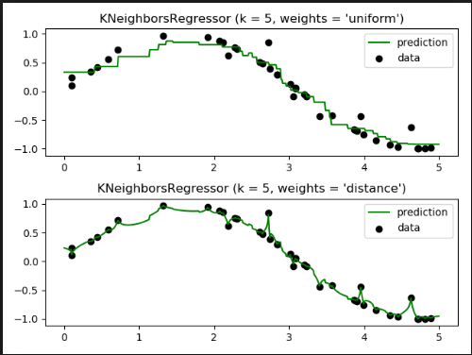
Models used for training- iii) KNN Regressor Model
K nearest neighbors is a simple algorithm that stores all available cases and predict the numerical target based on a similarity measure (e.g., distance functions).
The value of ‘K’ should be usually large since it reduces noise, but the distinct boundaries between the feature spaces get blurred. Cross Validation has been used to obtain a good value of ‘K’ before the prediction is made.
Department of Electronics and Telecommunication Engineering Semester VIII 2015-19

Slide 24
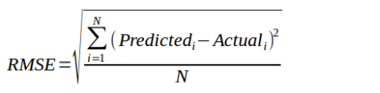
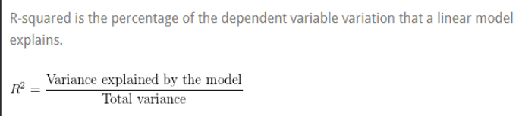
Error Calculation
RMSE -The root-mean-squared error (RMSE) is a measure of how well your model performed. It does this by measuring difference between predicted values and the actual values.
R-squared -It is the percentage of the response variable variation that is explained by a linear model.
Department of Electronics and Telecommunication Engineering Semester VIII 2015-19

Slide 25
Automated Watering System and Web App
It consists of a circuit with connecting the water pump with a pipe which water the plant once everyday based on the prediction of the amount of water to be put in the plant.
The web app was designed in order to help the user monitor the water added in the plant and check the status of the plant health.
The total water present in the container is recorded and the predicted value is subtracted from it. This gives the water remaining in the container which can be monitored through the app.
An alert is send when the water level has reduced below a threshold in the container.
Department of Electronics and Telecommunication Engineering Semester VIII 2015-19

Slide 26

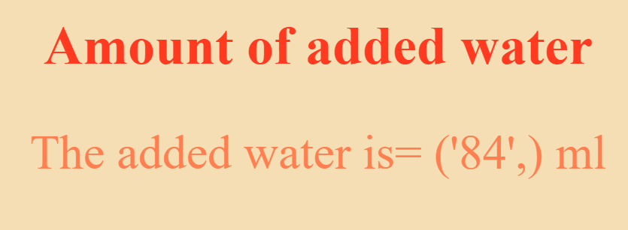
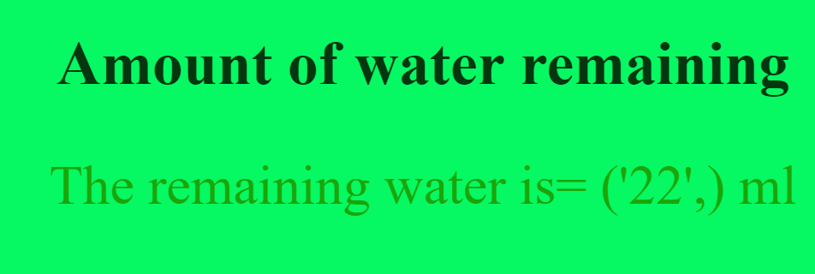
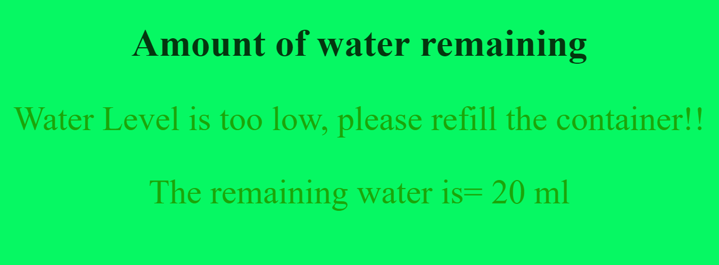
Web application
Department of Electronics and Telecommunication Engineering Semester VIII 2015-19

Slide 27
Result and Analysis
The results obtained after the process of dataset collection, data visualization and data modelling show the predicted values of the output water amount that is put in the plant which is adequate for the growth of the plant and also prevents a situation where the water added to the plant is in excess.
The results were collected in the following way :
Train-test-split process.The dataset was divided into training and testing data which is then sent as an input in the prediction models.
The R-Squared value of the predicted water output is then scrutinized.
Root Mean Square Error of the prediction (RMSE) was computed and analysed.
Department of Electronics and Telecommunication Engineering Semester VIII 2015-19

Slide 28


Results
Linear Regression
Splitting of data ratio | Case | Output water predicted (ml) | RMSE | R-squared | Coefficients | Probability values (corresponding to titles in coefficient column)
80% training, 20% testing | All three values with constant | 59.664 | 11.45 | 0.659
Department of Electronics and Telecommunication Engineering Semester VIII 2015-19

Slide 29
Results
Linear Regression
Splitting of data ratio | Case | Output water predicted (ml) | RMSE | R-squared | Coeffiients | Probability values (corresponding to titles in coefficient column)
70% training, 30% testing | All three values with constant | 47.34 | 9.84 | 0.659

Slide 30
Results
Linear Regression
Splitting of data ratio | Case | Output water predicted (ml) | RMSE | R-squared | Coeffiients | Probability values (corresponding to titles in coefficient column)
60% training, 40% testing | All three values with constant | 73.66 | 17.63 | 17.63

Slide 31
Results
Support Vector Regression
Kernel | Splitting of data ratio | Output water predicted (ml) | RMSE
Linear | 60% training, 40% testing | 134.09 | 15.513
RBF | 60% training, 40% testing | 65 | 32.135

Slide 32

Results
KNN Regression for 70-30

Slide 33
Conclusion
After extensive experimentation and analysis it is concluded that along with soil moisture, humidity, and temperature values, there are also some more unknown factors that must be taken into consideration for determining the output water amount. The output water amount is dependent on other factors as well. These factors may affect the soil moisture in different ways.
The values of the output water to be added depend heavily on the soil moisture values.
The RMSE values vary for different cases when the data is split differently each time. The RMSE and the coefficients of the model summary present the effect of the different inputs on the output water amount.
Department of Electronics and Telecommunication Engineering Semester VIII 2015-19

Slide 34
Conclusion
The R-squared value is highest when the soil moisture values and its combinations are put in the prediction model. The data points are best fit when the soil moisture is considered as a feature. The R-squared value does not change when the data splitting ratio is changed.
The train-test-split method provides unreliable results, due to small value of dataset and lesser parameters. This problem can be combated with cross validation, which provides stable results and better approximations for the output water amount values.

Slide 35
Future Scope
More number of plant species can be used for experimentation.
The data collection can be done for multiple seasons. This can increase the accuracy of the predicted output.
More parameters can be taken into account for prediction which can provide better results.
Sophisticated equipment can be used in the complete system to decrease errors and increase power efficiency of

Slide 36
References
Jones, H. G. (2006). Monitoring plant and soil water status: Established and novel methods revisited and their relevance to studies of drought tolerance. Journal of Experimental Botany.
Salim, M. (1989). Effects of salinity and relative humidity on growth and ionic relations of plants. New Phytologist.
Cowling, S. A., & Sage, R. F. (1998). Interactive effects of low atmospheric CO2 and elevated temperature on growth, photosynthesis and respiration in Phaseolus vulgaris. Plant, Cell and Environment.
Ananthi, N., Divya, J., Divya, M., & Janani, V. (2017). IoT based smart soil monitoring system for agricultural production. 2017 IEEE Technological Innovations in ICT for Agriculture and Rural Development (TIAR).
Department of Electronics and Telecommunication Engineering Semester VIII 2015-19

Slide 37
References
Pernapati, K. (2018). IoT Based Low Cost Smart Irrigation System. 2018 Second International Conference on Inventive Communication and Computational Technologies (ICICCT).
Gagandeep, Arora, D., & Saini, H. S. (2017). Design and implementation of an automatic irrigation feedback control system based on monitoring of soil moisture. 2017 International Conference on Inventive Computing and Informatics (ICICI).
Qi, C., Wenbiao, W., & Siyuan, W. (2015). Application of indoor temperature prediction based on SVM and BPNN. The 27th Chinese Control and Decision Conference (2015 CCDC).
Meng, L., Shi, J., Wang, H., & Wen, X. (2013). SVM with improved grid search and its application to wind power prediction. 2013 International Conference on Machine Learning and Cybernetics.
Liu, S., & Zhou, F. (2010). On stock prediction based on KNN-ANN algorithm. 2010 IEEE Fifth International Conference on Bio-Inspired Computing: Theories and Applications (BIC-TA).
Department of Electronics and Telecommunication Engineering Semester VIII 2015-19

Slide 38
References
Tissera, M. D., & Mcdonnell, M. D. (2016). Modular expansion of the hidden layer in Single Layer Feedforward neural Networks. 2016 International Joint Conference on Neural Networks (IJCNN).
R. Subalakshmi and Anu Amal, (2016). “GSM Based Automated Irrigation using Sensors” presented at Special Issue published in International Journal of Trend in Research and Development (IJTRD),
John R. Dela Cruz, Renann G. Baldovino, Argel A. Bandala, Elmer P. Dadios,( 2017). “Water Usage Optimization of Smart Farm Automated Irrigation System Using Artificial Neural Network”, (ICoICT).
Remco R. Bouckaert,(2013) “Weka Manual for Version 3-7-8”, The University of Waikato.
H. B. Lu and J. L. Wang, (2014). Optimizing the exhaust carbon contented of fly ash of power station boiler based on LIBSVM and artificial intelligence algorithm, Journal of Northeast Dianli University.
Department of Electronics and Telecommunication Engineering Semester VIII 2015-19

